Slide 1

Smart Expense Tracker
By B. Shivaji Ganesh

Slide 2

INTRODUCTION
The Smart Expense Tracker Project aims to provide insightful data analysis to help individuals manage their finances effectively. Through various features, users will gain visibility into their spending habits and identify areas for savings.

Slide 3




KEY OBJECTIVES
Automation Expense Management
Reduce manual effort by automatically tracking and categorizing expenses
Analyze spending patterns through reports and visualizations for better financial decisions
Provide Data Driven-Insight
Enhance Budget
Control
Help users set budget, monitor expenses, and prevent overspending effectively
Notes:
Photo by John Schnobrich on Unsplash

Slide 4
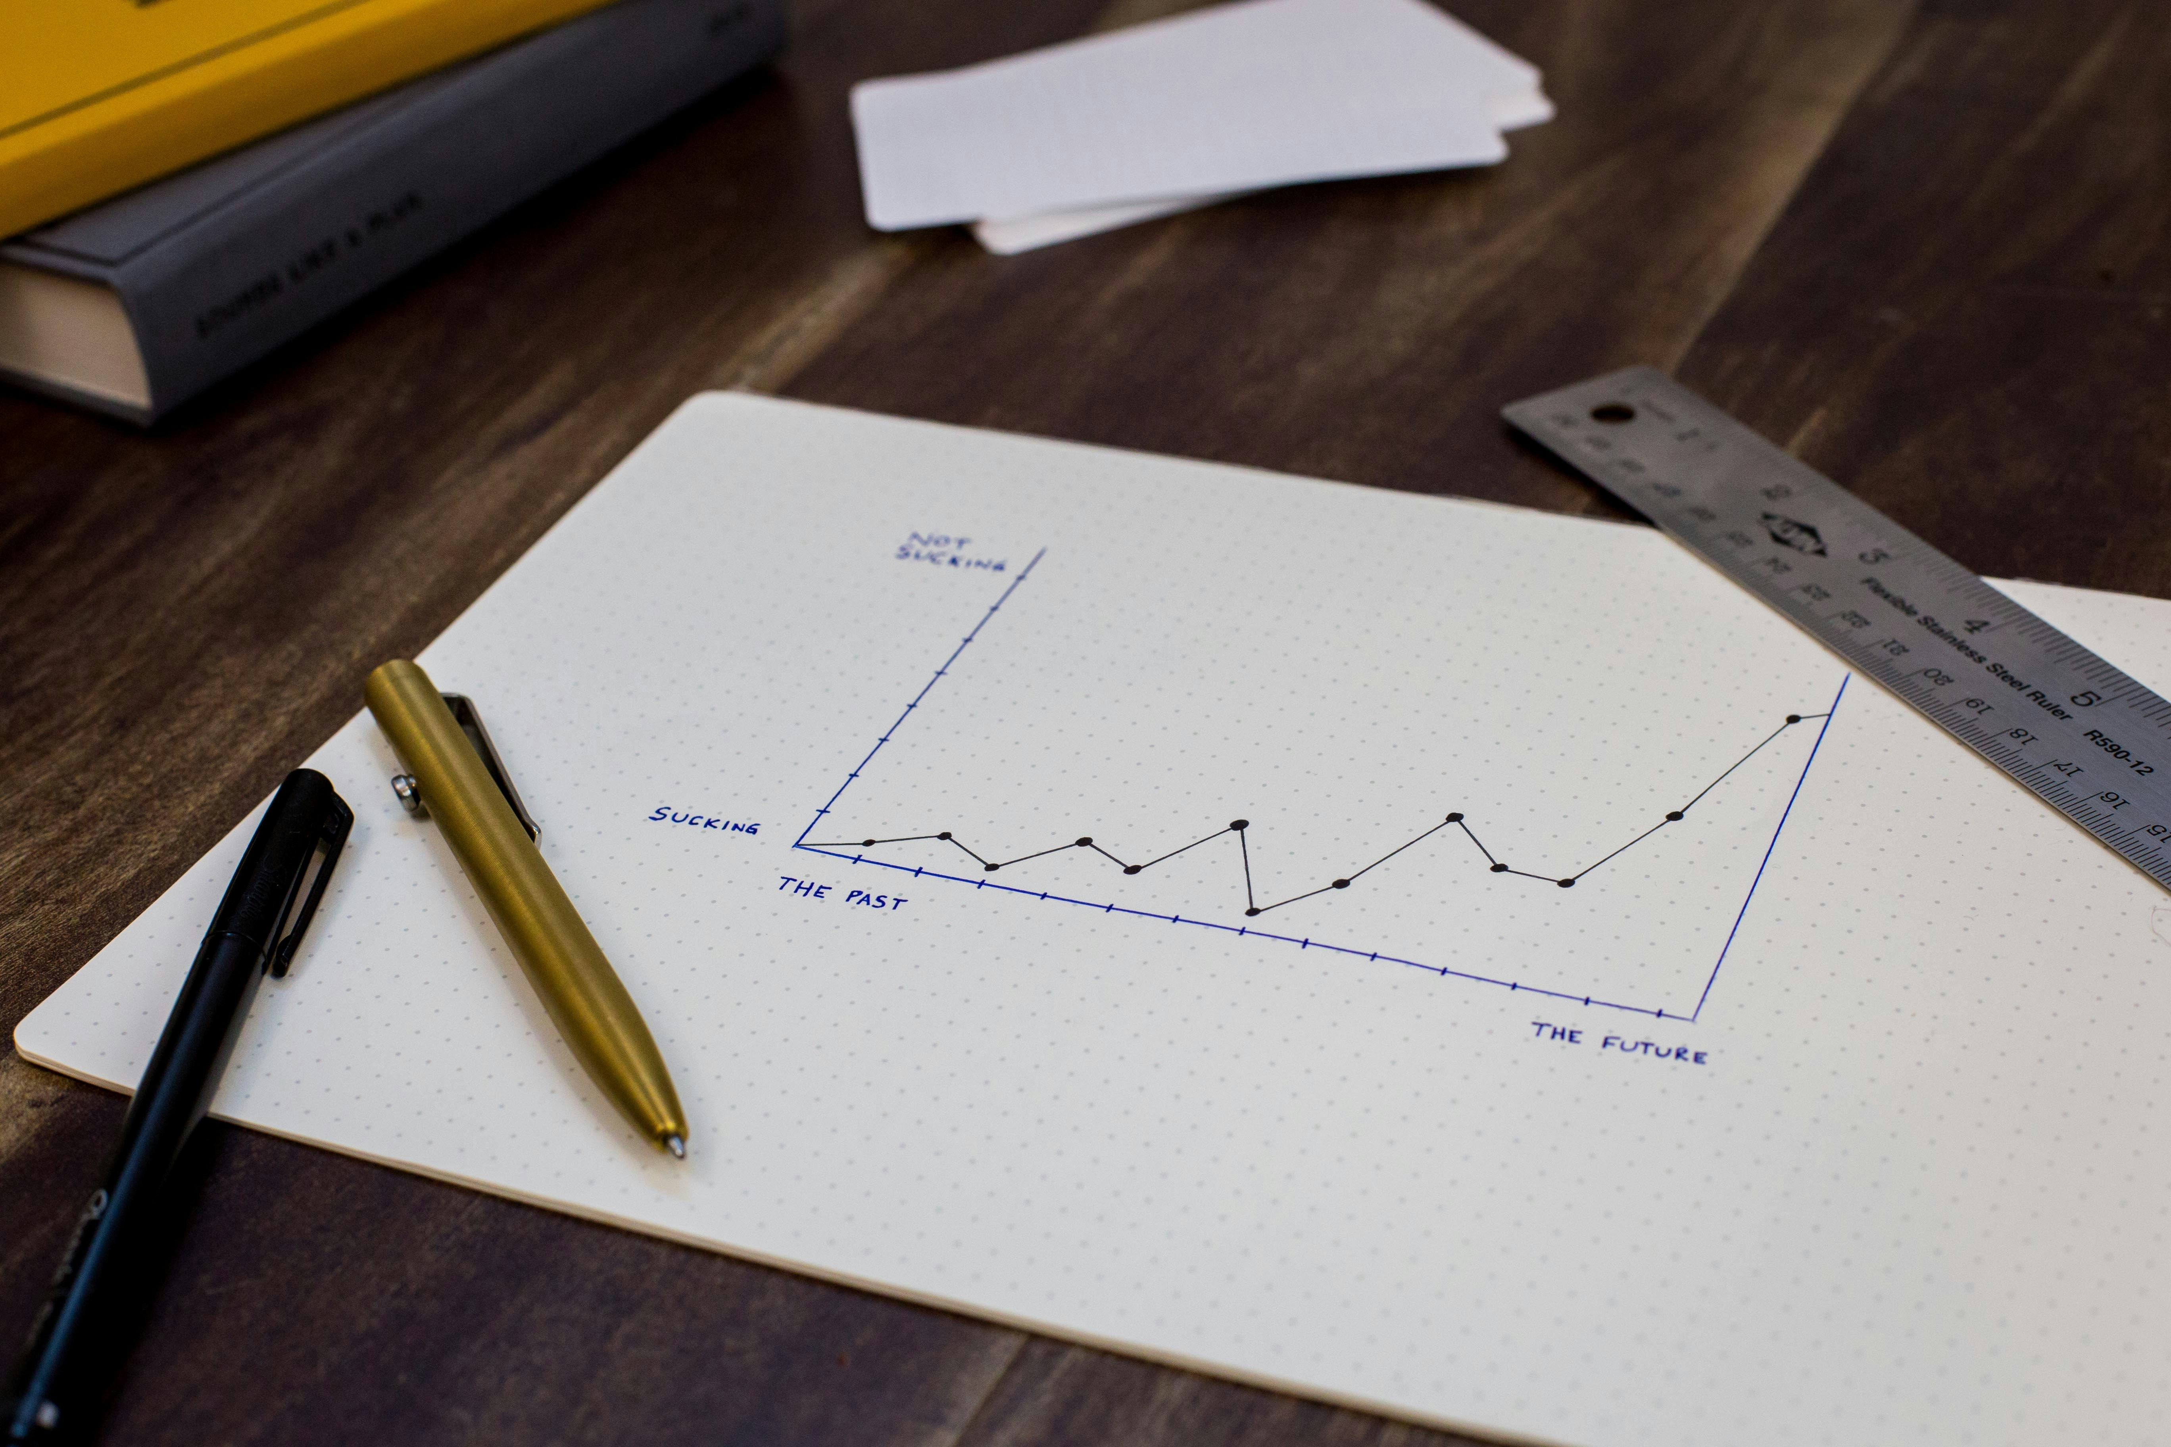
REQUIREMENTS
Python (Core development)
NumPy & Pandas (Data processing)
Matplotlib & Seaborn (Data visualization)
Jupyter Notebook (Development environment)
SQLITE – PYTHON BUILTIN DATABASE
SQL/Django (Optional - Database management)

Slide 5
KEY FEATURES
Categorizing
TRACKING
Budgeting
ANALYSING
Security
Automation
Monitors and records expenses.
Sorts spending into meaningful groups
Helps set and control financial limits
Provides insights through reports and charts.
Reduces manual entry with smart inputs.
Ensures data privacy and protection.

Slide 6
WORK FLOW
Start Testing
Add Sample Expenses
Retrieve & Display Expenses
Check if Expenses Exist?
YES
NO
Delete 1st Expense
Skip to Next Step
Retrieve & Display Updated Expenses
Check if Data is Empty?
YES
NO
System Reset
Investigate Issue
Run Expense Visualization
End Testing

Slide 7
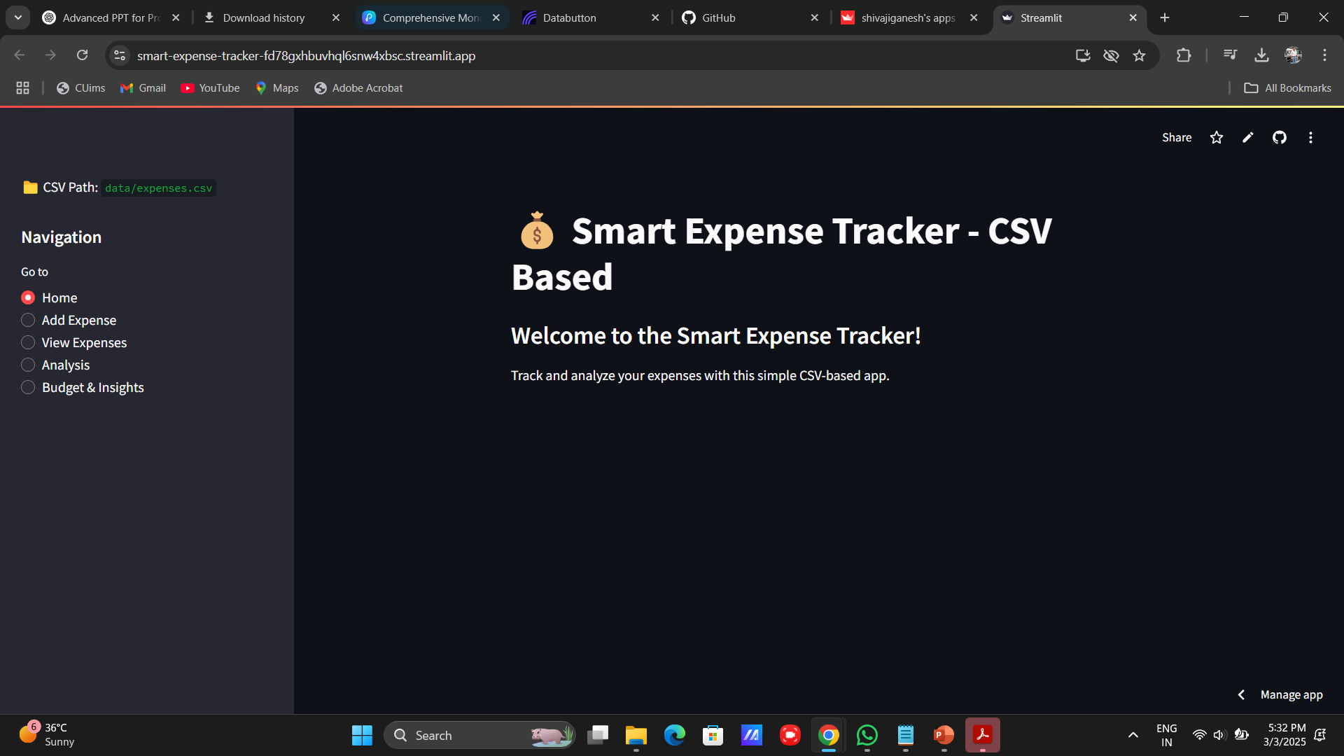
APPLICATION INTERFACE - 1
Smart Expense Tracker - CSV Based helps track and analyze expenses.
CSV Path: Displays the data storage file (expenses.csv).
Navigation Panel: Allows switching between Home, Add Expense, View Expenses, Analysis, and Budget & Insights.
Dark-Themed UI: Clean and minimalistic design for better readability

Slide 8
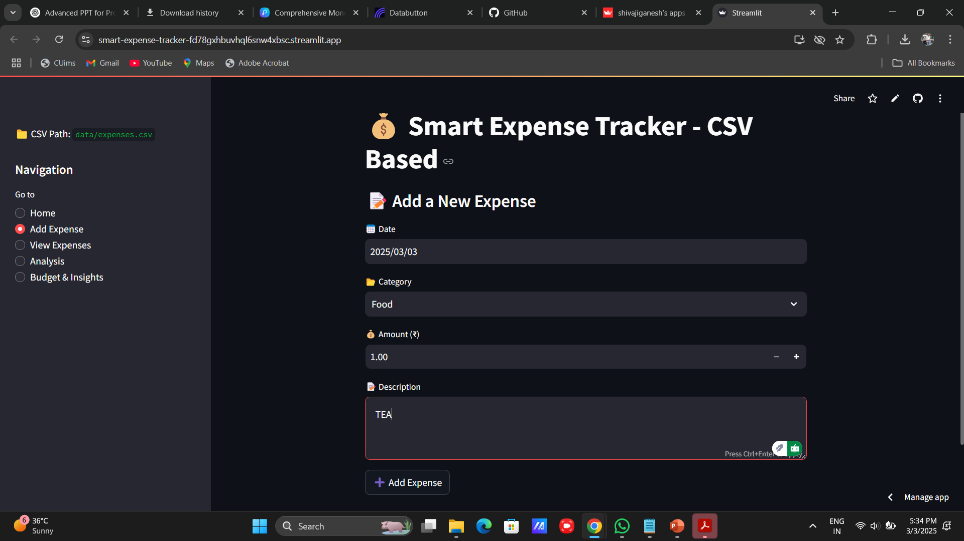
APPLICATION INTERFACE - 2
Allows users to add new expenses by entering the date, category, amount, and description.
Predefined categories (e.g., Food) help in organizing expenses.
Amount field supports both manual entry and increment/decrement using buttons.
"Add Expense" button saves the entered data into the CSV file for tracking.

Slide 9
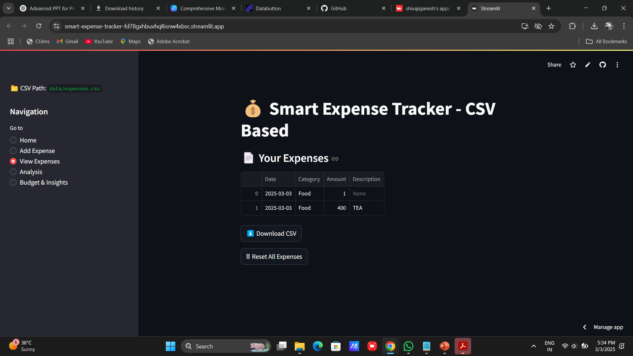
APPLICATION INTERFACE - 3
Displays recorded expenses in a tabular format (Date, Category, Amount, Description).
Download CSV option allows users to save expense data locally.
Reset All Expenses button clears all recorded data.
Helps in tracking spending patterns and managing budgets efficiently.

Slide 10
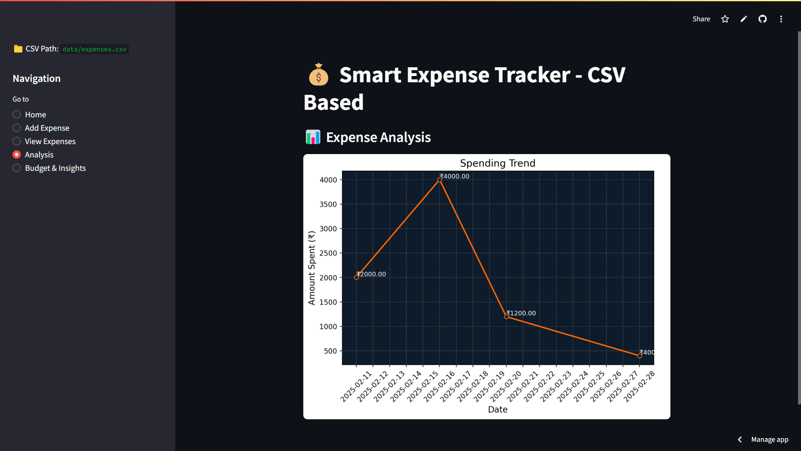
APPLICATION INTERFACE - 4
Displays a spending trend graph with expenses plotted over time.
Helps visualize spending patterns with clear labels on data points.
Useful for identifying spikes in expenses (e.g., ₹400 on 2025-02-27).

Slide 11
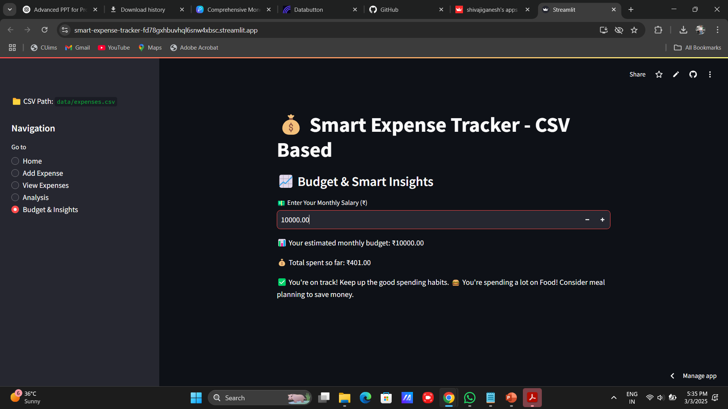
APPLICATION INTERFACE - 5
Users can input their monthly salary.
Displays estimated budget and total spent so far.
Provides smart insights based on spending habits (e.g., food expenses warning).

Slide 12
DATA PROCESSING
1. How Data is Stored & Retrieved
Storage Format: CSV (Comma-Separated Values)
Location: data/expenses.csv (easily accessible & editable)
Retrieval: Data is read from the CSV file using Pandas, allowing efficient filtering & analysis.
2. Using NumPy & Pandas for Data Handling
Pandas – Used for:
Reading & Writing CSVs (pd.read_csv(), df.to_csv())
Filtering & Sorting Data (df[df['Category'] == 'Food'])
Aggregation & Analysis (df.groupby('Date')['Amount'].sum())
NumPy – Used for:
Mathematical operations on expenses
Optimized numerical calculations for trends & insights
3. SQL Integration (if used), Currently CSV-based storage is used. However, for scalability
SQLite / MySQL can be integrated for structured data management
SQL Queries (SELECT * FROM expenses WHERE Category='Food') can be used for advanced filtering

Slide 13
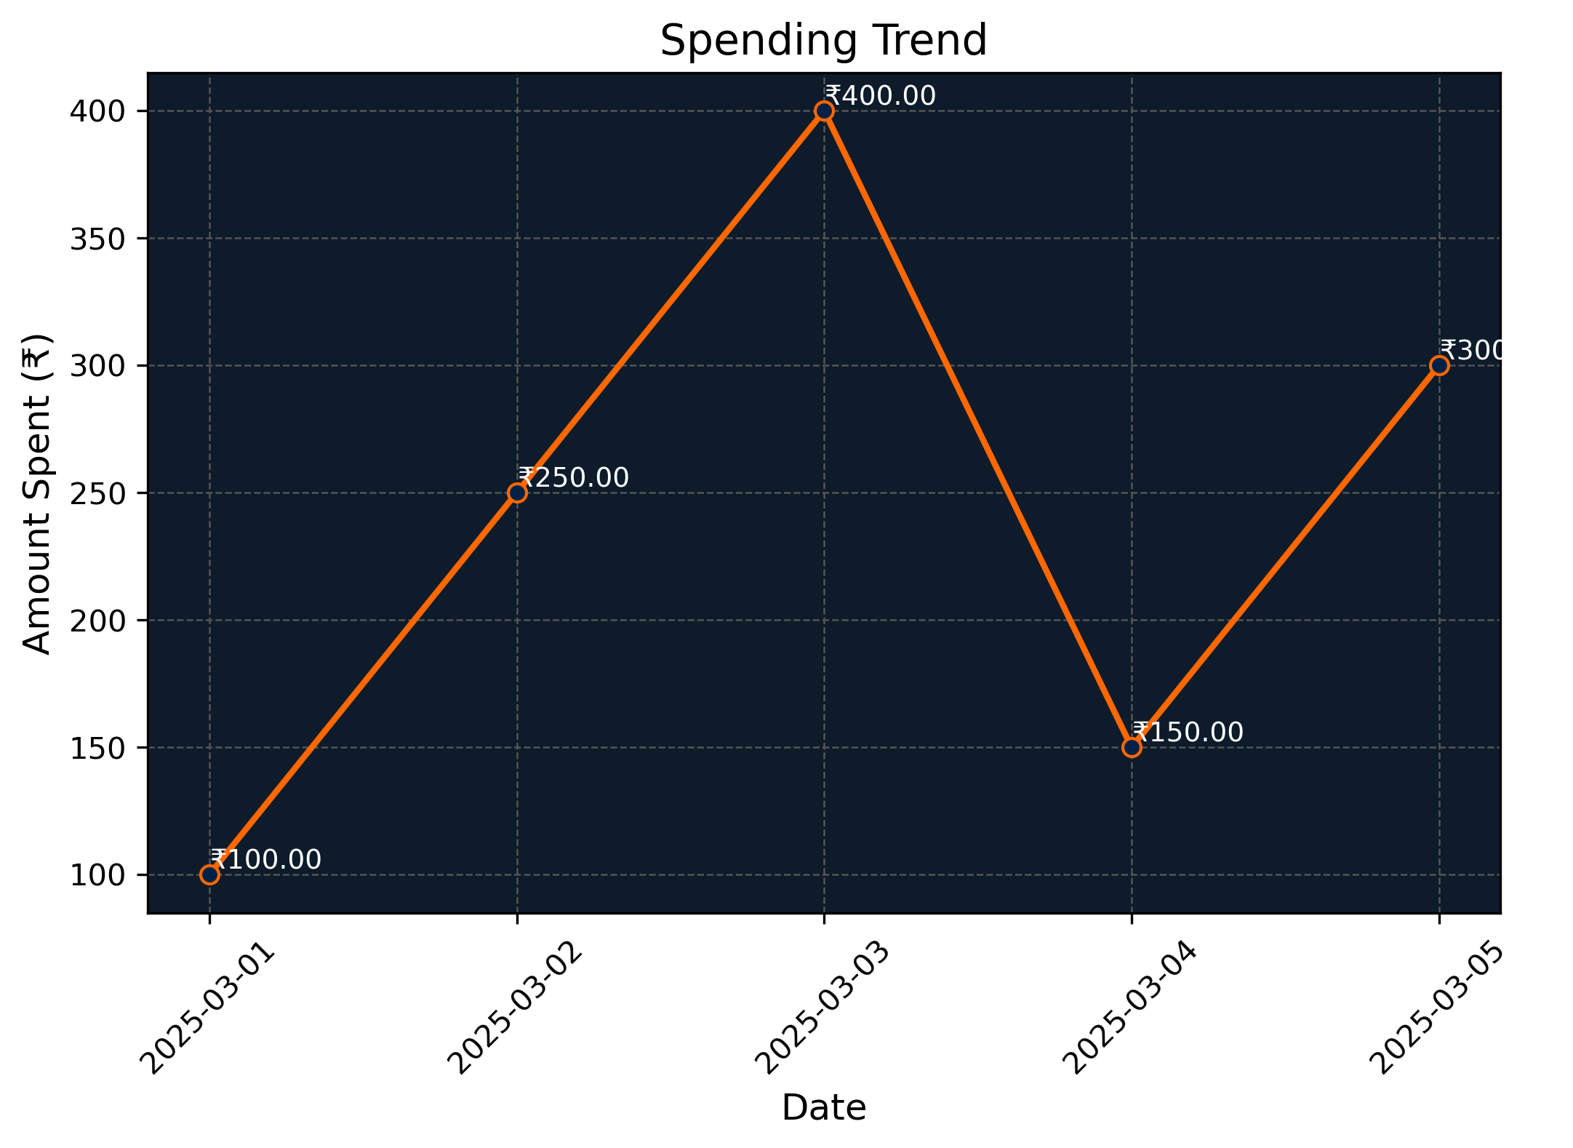
GRAPHS & VISUALS IN SMART EXPENSE TRACKER
Only Line Charts are Used (No Bar/Pie Charts)
Types of Line Charts Implemented
Monthly Expense Trends
Displays spending patterns over time
Helps track financial habits and predict future expenses
Spending Category Breakdown
Shows how expenses are distributed across different categories
Helps identify areas of high spending

Slide 14
FUTURE ENHANCEMENTS
Larger Database Integration
→ Expanding storage capacity by connecting to a more scalable database for better data management.
User-Specific Login Credentials
→ Implementing secure login access to ensure individualized expense tracking for each user.
Enhanced Analysis with Multiple Charts
→ Adding pie charts alongside line graphs for better spending insights.
Improved Category Selection
→ Replacing dropdown selection with quick-access buttons for a smoother user experience.

Slide 15
CONCLUSION
Smart Expense Tracker simplifies expense management by providing a user-friendly interface, insightful analysis, and automated tracking.
With line chart visualization and category-based expense tracking, users can monitor spending habits efficiently.
Future enhancements, such as larger database integration, user login credentials, and improved UI features, will make the system even more secure and scalable.
This project serves as a practical and efficient solution for managing daily expenses, ensuring better financial planning.

Slide 16
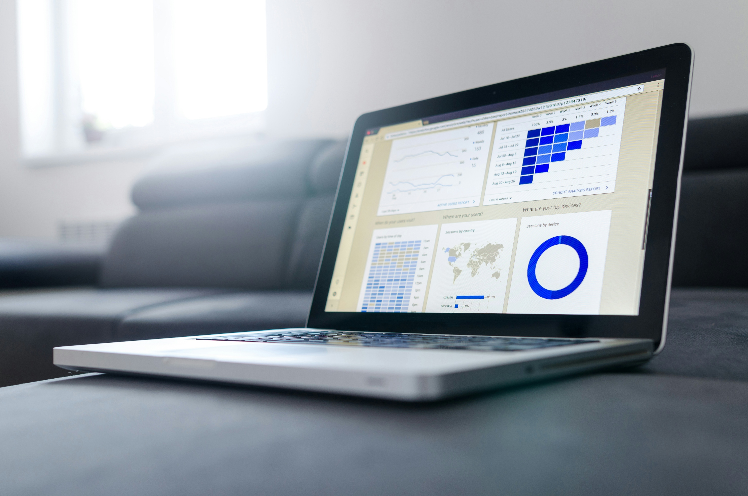
Thank You.
AF0465229
Project By
B. Shivaji Ganesh
Notes:
https://unsplash.com/

